Slide 1

Alter-Learning Connect Registration and Authentication

Slide 2
Content
Basic Flow for demo XR rooms addition into portals
Participant Panel (Host) for demo
AL-CLASS –Adding Hybrid-Classroom into the Portals and moving the Players to it.
AL-ASSISTANT – Loading AL into the panel (Voice and text)

Slide 3
Content
Basic Flow for demo XR rooms addition into portals

Slide 4
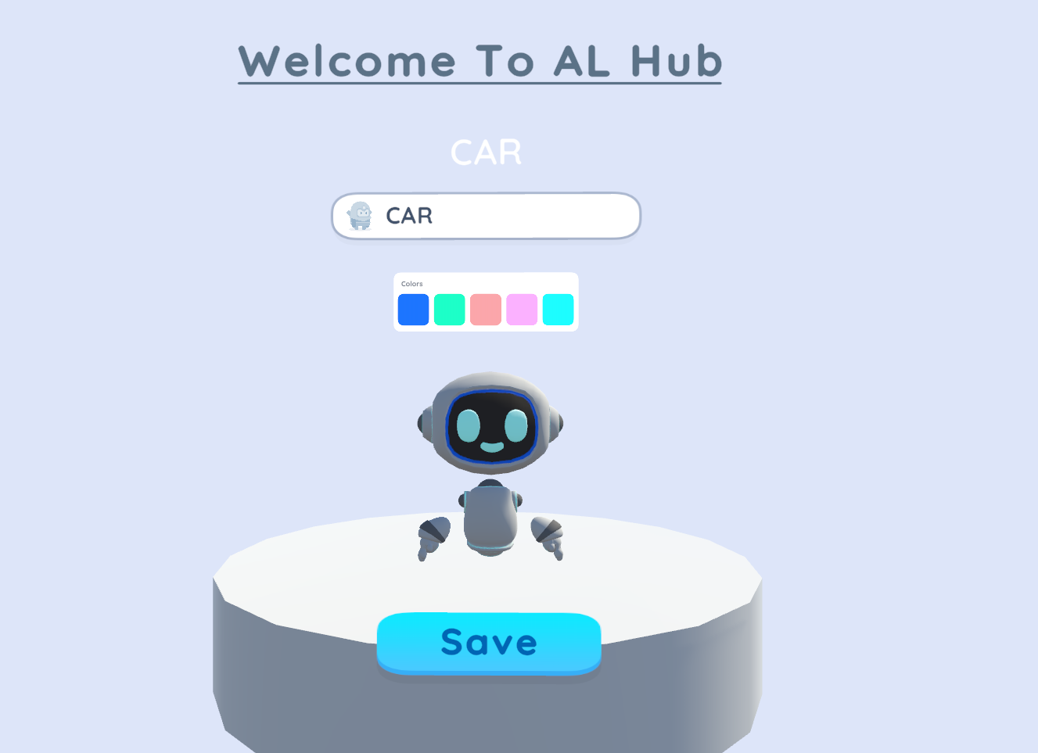
0
Name must be transferred from AL-Connect HUB – Must add an option to exit or leave the Hub come to the AL-Connect Hub
Exit

Slide 5
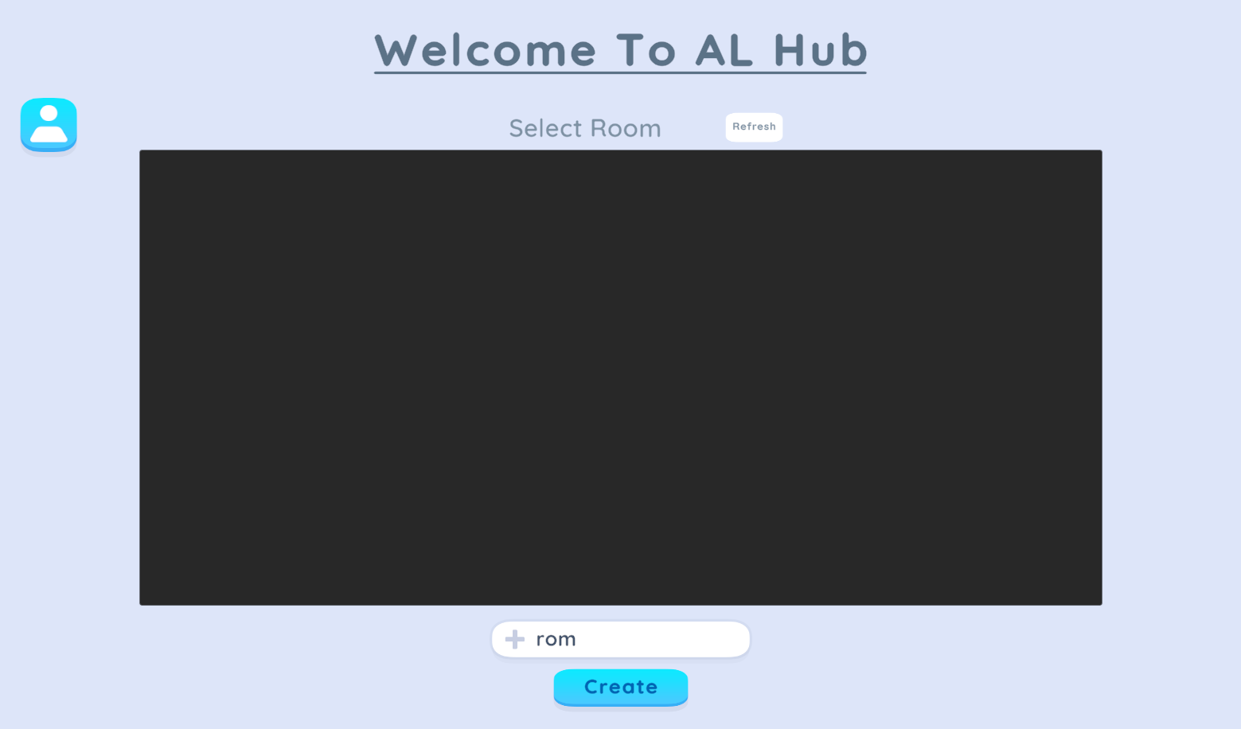
0
Name must be transferred from AL-Connect HUB – Must add an option to exit or leave the Hub come to the AL-Connect Hub
Exit

Slide 6
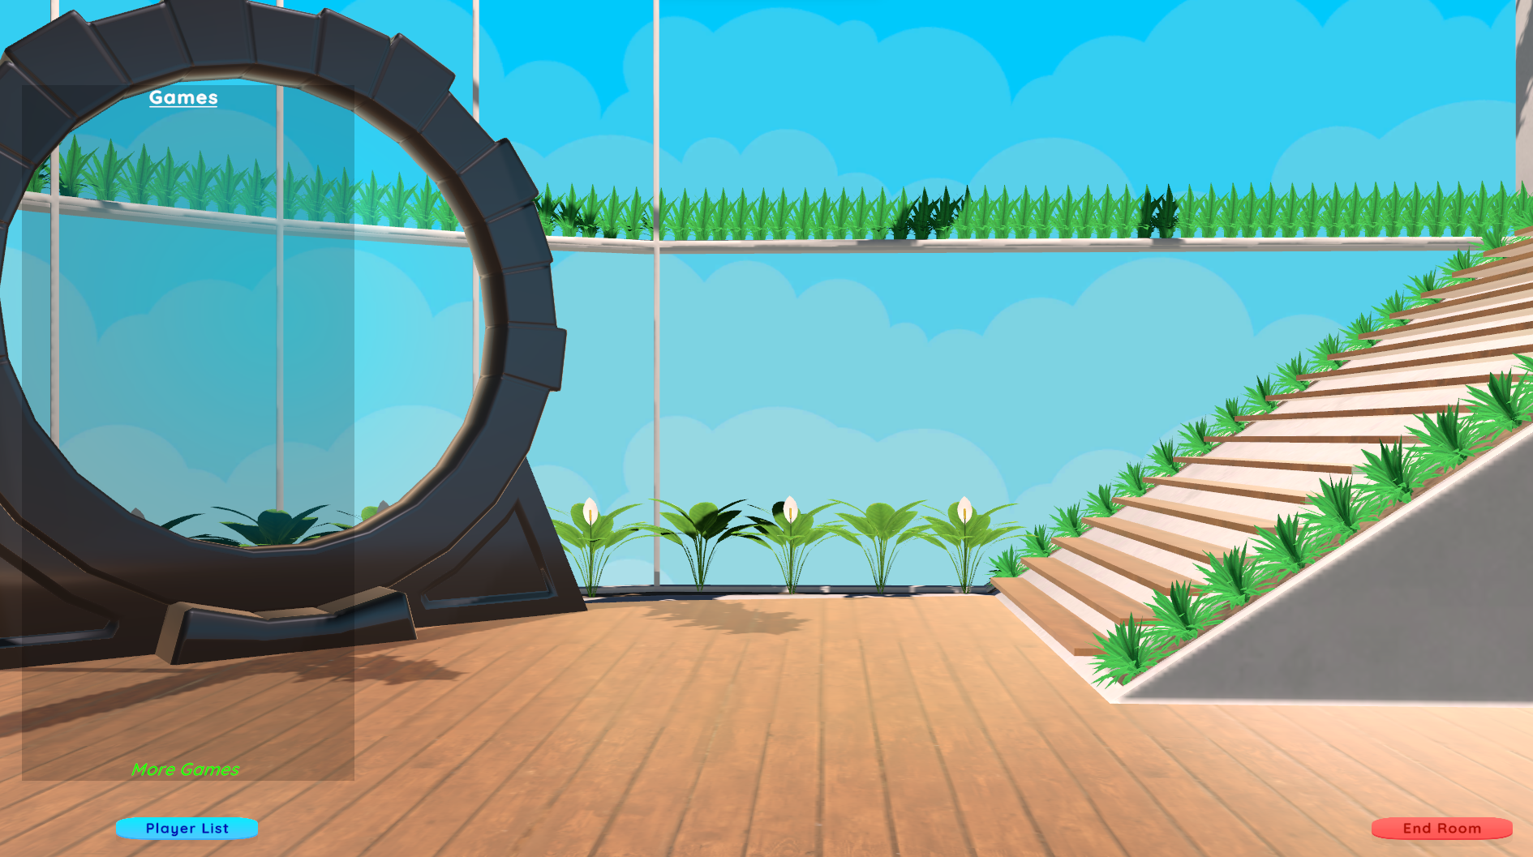
1
Press Keyboard bar (Windows/MACOS/WebGL 3D), Controller (TBD) VR Oculus Quest 2, touch icon dashboard (Tablet and Mobile Version 3D) (Transparent Dashboard will appears in the side)
Participants
XR Rooms
Edu-games
AL Assistant
Close
Exit
2
Using Mouse (Windows/MACOS/WebGL 3D), controller (TBD)( VR Oculus Quest 2), touch screen (Tablet and Mobile)

Slide 7

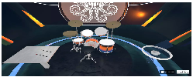
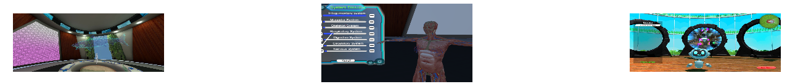
Using Mouse (Windows/MACOS/WebGL 3D), controller (TBD)( VR Oculus Quest 2), touch screen (Tablet and Mobile)
Press XR Rooms button
3
X
X
XR ROOMS
VR MARINE BIOLOGY
X
VR MUSIC HALL
VR HUMAN ANATOMY
X
X
Participants
4
XR Rooms
Edu-games
5
ADD
AL CLASS
AL Assistant
Close
Exit
A screen appears reading the list of XR rooms downloaded by the AL-Connect HUB with option to select [X] add into the portals (Using mouse click on Desktop (Windows, MACOS, Web) and touch in Tablet and Mobile Version, or enter function controller VR Oculus Quest 2
4
5
After select the XR Rooms to add into the Session and portals. A new screen appears with the map of the HUB.

Slide 8
Portals needs to show the XR rooms selected and allow them to enter and join the XR Rooms
Portals needs to show the XR rooms selected and allow them to enter and join the XR Rooms
The flow is similar and can be combined Edugame, Cassual game and XR Rooms, the condition is that builds needs to be downloaded by the AL-Connect Hub into the User Device.

Slide 9
Using Mouse (Windows/MACOS/WebGL 3D), controller (TBD)( VR Oculus Quest 2), touch screen (Tablet and Mobile)
Press Participants
3
PARTICIPANTS
NAME
STATUS
CHAT
MOOD
CONTACT
(Host)
CARLOS COLMAN
EMIRHAN
AITANA
Participants
4
XR Rooms
Edu-games
AL Assistant
Close
Exit
A screen appears reading list of participant Showing Status (active/no active), Chat (Speaking or Mutted), Mood (emotion API Neutral, Sad, Ungry, Happy, etc), Contact (open a channel using a private voice chat).
4

